Slide 1



UE20CS334 NATURAL LANGUAGE PROCESSING
PHASE - I REVIEW
Character Sketch and Age Demographic Analysis of dialogues using Machine Learning Algorithms
PRESENTED BY: CHARVI BANNUR (PES1UG20CS638), CHAITRA BHAT (PES1UG20CS635), SAI SHRUTHI SHASHIDHAR (PES1UG20CS367),
SURAJ R GAUTHAM (PES1UG20CS448)

Slide 2
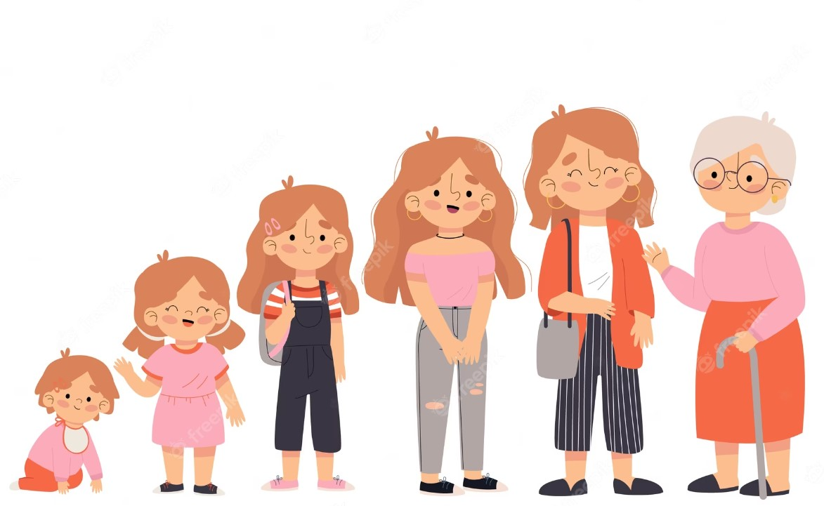
Age Demographics and Character Traits
AGE DEMOGRAPHY
Age demographics are data and statistical characteristics about people as categorized by age.
USES OF DEMOGRAPHY
Demographic data in general is very useful to understand how to market to consumers and plan strategically for future.
APPLICATIONS
Character trait prediction has a lot of applications, like business recommendation systems, human resource management, author identification and psychological treatment.

Slide 3
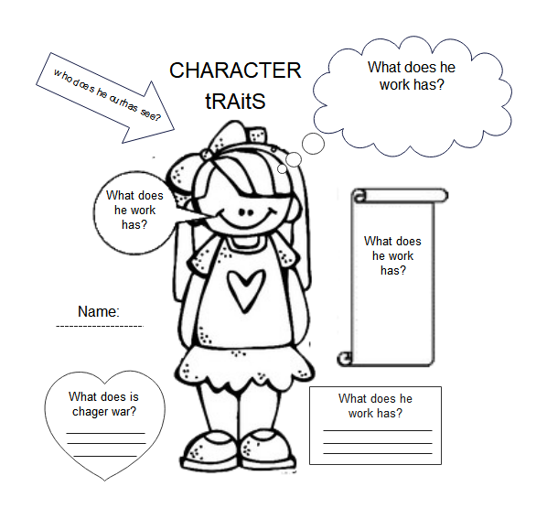
Character Traits
DEFINITION
DESCRIPTION
A character analysis is an in-depth interpretation of the characters within a literary work and their relation to each other and the plot.
A character analysis is an exploration of the traits, personality and characteristics of a character within a story.
PURPOSE
METHODOLOGY
The purpose of a character analysis is to garner a deeper understanding of the story and the interconnections between the various characters.
Analysing various traits of the characters using NLP techniques.
Apply suitable ML model further.

Slide 4
LITERATURE SURVEY

Slide 5




Sl no.
Title of the paper
Year of publication
Author
Aim
Dataset
Method
Challenges/ Gaps
Accuracy and comments
[1]
Sl no.
Title of the paper
Year of publication
Author
Aim
Dataset
Method
Challenges/ Gaps
Accuracy and comments
Computational personality recognition in social media
2016
Golnoosh Farnad et. al
Classify Personality traits like extroversion, openness, agreeableness, Conscientiousness, Emotional stability
Uses data from the myPersonality project. Twitter, Facebook and Youtube.
It uses regression methods on after various features have been extracted. LIWC, NRC, MRC and other psycho-lingual feature extraction techniques
Very few personality traits are predicted. Simple regression model.
RMSE 0.807 ishh
[1]
TutorialVQA: Question Answering Dataset for Tutorial Videos
2020
Anthony Colas et. al
Non-factoid VQA on tutorial videos
Unique tutorial based dataset, created using Amazon mechanical Turk
Encoding and decoding -> BiLSTMs + TF-IDF
Overlapping errors + model fails to identify precise boundaries
63.85%
[2]
Personalized Dialogue Generation with Diversified Traits
2019
Yinhe Zheng et. al
To predict gender, age and location as a key-value pair using character traits present in dialogues
Unique generated dataset called PersonalDialog
Seq2Seq models along with fusion with personality attention
Predicts only Age, Gender, Location
96%
[2]
A comparative study of language transformers for video question answering
2021
Zekun Yang et. al
Usage of transformers + novel architecture on various existing datasets
Multiple existing datasets of TV shows and movies
BERT + XLNet + RoBERTa + ALBERT
Focuses mainly on tv shows and movies
72 %
[3]
Text based personality prediction from multiple social media data sources using pre-trained language model and model averaging
2021
Hans Christian et al.
Detailed Big Five personality detection
Twitter and Facebook data
Essemble on RoBERTa+BERT+XLNet
-
86%
[3]
KnowIT VQA: Answering Knowledge-Based Questions about Videos
2019
Noa Garcia et al.
Knowledge based VQA compared with visual, temporal and textual questions
Big Bang Theory dataset, created using Amazon mechanical Turk
ROCK- heavy knowledge base + knowledge base cleaning BERT + image features, concepts features + facial features and caption features
Knowledge base might not be sufficient
60-70% based on situations

Slide 6


Sl no.
Title of the paper
Year of publication
Author
Aim
Dataset
Method
Challenges/ Gaps
Accuracy and comments
[4]
Sl no.
Title of the paper
Year of publication
Author
Aim
Dataset
Method
Challenges/ Gaps
Accuracy and comments
Personality Recognition in Conversations using Capsule Neural Networks
2019
Esteban A. Ríssola et. al
Big Five personality traits highlighting
Conversational dataset- not publicly available
Capsule Neural Networks using custom routing algorithm
Categorical prediction rather than continuous.
83% Recall
[1]
TutorialVQA: Question Answering Dataset for Tutorial Videos
2020
Anthony Colas et. al
Non-factoid VQA on tutorial videos
Unique tutorial based dataset, created using Amazon mechanical Turk
Encoding and decoding -> BiLSTMs + TF-IDF
Overlapping errors + model fails to identify precise boundaries
63.85%
[5]
A Machine Learning Approach to Demographic Prediction using Geohashes
2017
Avipsa Roy et. al
Develop a model which will predict the age and gender of users in separate groups with respect to their most frequently visited location.
Real dataset of mobile phone users collected and shared by a telecommunication provider
Discriminant Analysis approach from the Python scikit-learn, FPGrowth model, Decision Trees
Demographic information such as age and gender are mostly unavailable to app developers for open access due to privacy concerns
71.62% and 96.75% for predicting gender and age groups of the users respectively.
[2]
A comparative study of language transformers for video question answering
2021
Zekun Yang et. al
Usage of transformers + novel architecture on various existing datasets
Multiple existing datasets of TV shows and movies
BERT + XLNet + RoBERTa + ALBERT
Focuses mainly on tv shows and movies
72 %
[6]
Personality Classification from Online Text using Machine Learning Approach
2020
Alam Sher Khan et.al
This work provides the basis for developing a personality identification system which could assist organization for recruiting and selecting appropriate personnel.
Publically available benchmark dataset from Kaggle
KNN, Decision Tree, Random Forest, MLP, Logistic Regression (LR), SVM, XGBoost, MNB and Stochastic Gradient Descent (SGD).
The skewness of the dataset is the main issue.
XGBoost classifier is outstanding by achieving more than 99% precision and accuracy.
[3]
KnowIT VQA: Answering Knowledge-Based Questions about Videos
2019
Noa Garcia et al.
Knowledge based VQA compared with visual, temporal and textual questions
Big Bang Theory dataset, created using Amazon mechanical Turk
ROCK- heavy knowledge base + knowledge base cleaning BERT + image features, concepts features + facial features and caption features
Knowledge base might not be sufficient
60-70% based on situations

Slide 7


Sl no.
Title of the paper
Year of publication
Author
Aim
Dataset
Method
Challenges/ Gaps
Accuracy and comments
[7]
Statistical Analysis of Personality and Identity in Chats Using a Keylogging Platform
2014
Giorgio Roffo et. al
Semi-structured chats between 50 subjects, whose personality traits have been analyzed through psychometric tests, and a single operator
The data collection has been based on a public social network, where the text chatting interface has been equipped with keylogging functionalities
LexicalFeatures, SyntacticFeatures, Turn-takingFeatures, Regression, Support Vector Regressor (-SVR) with RBF kernel.
-
63.5% AUC
Sl no.
Title of the paper
Year of publication
Author
Aim
Dataset
Method
Challenges/ Gaps
Accuracy and comments
[1]
TutorialVQA: Question Answering Dataset for Tutorial Videos
2020
Anthony Colas et. al
Non-factoid VQA on tutorial videos
Unique tutorial based dataset, created using Amazon mechanical Turk
Encoding and decoding -> BiLSTMs + TF-IDF
Overlapping errors + model fails to identify precise boundaries
63.85%
[8]
The demographics of computer-mediated communication: A review of social
media demographic trends among social networking site giants
2020
Sarah Gambo
SNSs(Social Network Sites) usage distributed amongst various demographic
groups, gender and SNS usage, and SNS and age factor.
Facebook, Whatsapp, Instagram analysis.
Social
Networking Site
, Percentage of internet
users using it
Demographic group this service is most
appealing to.
-
Tracking the global digital gender gap
Tracking the global digital gender gap
This review study explored the demographics of SNS usage using
three case-studies: Facebook, Instagram, and WhatsApp.
[2]
A comparative study of language transformers for video question answering
2021
Zekun Yang et. al
Usage of transformers + novel architecture on various existing datasets
Multiple existing datasets of TV shows and movies
BERT + XLNet + RoBERTa + ALBERT
Focuses mainly on tv shows and movies
72 %
[9]
Predicting Personality Using Answers to Open-Ended Interview Questions
2020
Madhura Jayaratne; Buddhi Jayatilleke
Textual content of
answers to standard interview questions related to past behaviour and situational judgement can be used to infer personality traits
Data from over 46,000 job applicants who completed an online chat
interview
HEXACO model of personality as
the underlying personality representation model, open-vocabulary approach in nlp, regression model
Used only the semantic level features (terms, topics etc).Exploring whether other types of
features, such as the use of parts of speech (POS), readability,
formality, use of emojis etc. can further increase the accuracy.
an average
correlation of 0.387 over other representation methods.
[3]
KnowIT VQA: Answering Knowledge-Based Questions about Videos
2019
Noa Garcia et al.
Knowledge based VQA compared with visual, temporal and textual questions
Big Bang Theory dataset, created using Amazon mechanical Turk
ROCK- heavy knowledge base + knowledge base cleaning BERT + image features, concepts features + facial features and caption features
Knowledge base might not be sufficient
60-70% based on situations

Slide 8


Sl no.
Title of the paper
Year of publication
Author
Aim
Dataset
Method
Challenges/ Gaps
Accuracy and comments
[10]
PANDORA Talks: Personality and Demographics on Reddit
2021
Matej Gjurkovic Mladen Karan et.al
To present the dataset PANDORA with both
personality and demographic labels. To showcase the usefulness of this dataset on three experiments. Present benchmark prediction models for all personality and
demographic variables.
Reddit comments of 10k users
Readily available MBTI/Enneagram labels can be used to estimate Big 5 traits, gender classifier based on certain personality traits and certain psycho-demographic
variables
Further efforts should be
directed toward efficient user representations and
more advanced deep learning architectures
-
Sl no.
Title of the paper
Year of publication
Author
Aim
Dataset
Method
Challenges/ Gaps
Accuracy and comments
[1]
TutorialVQA: Question Answering Dataset for Tutorial Videos
2020
Anthony Colas et. al
Non-factoid VQA on tutorial videos
Unique tutorial based dataset, created using Amazon mechanical Turk
Encoding and decoding -> BiLSTMs + TF-IDF
Overlapping errors + model fails to identify precise boundaries
63.85%
[11]
Supervised learning and
resampling techniques on DISC
personality classification using
Twitter information
in Bahasa Indonesia
2021
Ema Utami et.al
Analyzing profile data from personal social
media accounts reduces data collection time,
as this method does not require users to fill any questionnaires.
Raw data were derived from a
predefined dominance, influence, stability and conscientious (DISC) quiz website, returning 316,967 tweets
from 1,244 Twitter accounts
SMOTE, SMOTETomek, Hyper-parameter tuning on SVC, Random Forest Classifier, Gradient Boosting Classifier, AdaBoost Classifier, and Decision Tree Classifier, best model evaluation was performed.
A combination of textual and visual information derived from those platforms might be able to provide more
comprehensive and better classification results
SMOTETomek returning the best performance. support vector classifier F1-score of 56.43%
[2]
A comparative study of language transformers for video question answering
2021
Zekun Yang et. al
Usage of transformers + novel architecture on various existing datasets
Multiple existing datasets of TV shows and movies
BERT + XLNet + RoBERTa + ALBERT
Focuses mainly on tv shows and movies
72 %
[12]
Hybrid Machine Learning Technique for Personality Classification from Online Text using HEXACO Model
2022
P. William et. al
To find a suitable machine
learning technique for decision assistance for personality
classification that delivers accurate and comprehensible
results while remaining within budget constraints
Publicly accessible
benchmark dataset from Kaggle
Data Level Re-Sampling was done to balance the class instances by rescaling the training datasets.
Random Forests and Stacking ensemble methods for training.
K Fold Cross Validation for testing
For a more accurate
evaluation of the characteristics, the personality models
should be compared to the other model
I/E and S/N
characteristics had
99 percent precision.
and accuracy,.T/F and J/P dimensions had 95 percent accuracy.
[3]
KnowIT VQA: Answering Knowledge-Based Questions about Videos
2019
Noa Garcia et al.
Knowledge based VQA compared with visual, temporal and textual questions
Big Bang Theory dataset, created using Amazon mechanical Turk
ROCK- heavy knowledge base + knowledge base cleaning BERT + image features, concepts features + facial features and caption features
Knowledge base might not be sufficient
60-70% based on situations

Slide 9


Sl no.
Title of the paper
Year of publication
Author
Aim
Dataset
Method
Challenges/ Gaps
Accuracy and comments
[13]
One Graph to Rule them All: Using NLP and Graph Neural Networks to analyse Tolkien’s Legendarium
2022
Vincenzo Perri, Lisi Qarkaxhija, Albin Zehe, Andreas Hotho, Ingo Scholtes
Analyse micro and macro level details of characters within the corpus.
J.R.R. Tolkien's Legendarium
Graph neural networks for establishing connections and NLP in order to understand personality.
Embedding and co-occurrence prediction.
Predicting missing links in a graph
f1-score ≈ 79.7%, a precision ≈ 78.6% and a recall ≈ 82.6%
Sl no.
Title of the paper
Year of publication
Author
Aim
Dataset
Method
Challenges/ Gaps
Accuracy and comments
[1]
TutorialVQA: Question Answering Dataset for Tutorial Videos
2020
Anthony Colas et. al
Non-factoid VQA on tutorial videos
Unique tutorial based dataset, created using Amazon mechanical Turk
Encoding and decoding -> BiLSTMs + TF-IDF
Overlapping errors + model fails to identify precise boundaries
63.85%
[14]
Heroes, Villains, and the In-Between: A Natural Language Processing Appr ocessing Approach to Fairy Tales
2022
Ruby Alling Ostrow
Determine if it is possible to develop a computational model to extract the defining features from the odd and unpredictable nature of this classic form of literature.
Dataset of fifty Grimm’s fairy tales
SpaCy’s dependency parser.
Adolfo & Ong 2019.
Stanford CoreNLP library
Each tale has different number of characters making it hard to determine whether the identified main character is correct.
Adjective recognition is tricky, given the limitation to copular verbs, given the lack of knowledge of where an adjective describing a character may appear in the sentence.
On 13 average, there was a precision of 0.88, a recall of 0.91, and a F1 of 0.89
[2]
A comparative study of language transformers for video question answering
2021
Zekun Yang et. al
Usage of transformers + novel architecture on various existing datasets
Multiple existing datasets of TV shows and movies
BERT + XLNet + RoBERTa + ALBERT
Focuses mainly on tv shows and movies
72 %
[15]
Machine Learning Approach to Personality Type Prediction Based on the Myers–Briggs Type Indicator
2020
Mohammad Hossein Amirhosseini, Hassan Kazemian
Aim is to develop a new machine learning method for personality type prediction based on the MBTI.
Myers–Briggs Personality Type Dataset from Kaggle
The natural language processing toolkit (NLTK) and XGBoost, Numpy, sklearn
-
Extroversion (E) acc = 78.17%
Sensing (S) acc = 86.06%
Thinking (T) acc = 71.78%
Perceiving (P) acc = 65.70%
[3]
KnowIT VQA: Answering Knowledge-Based Questions about Videos
2019
Noa Garcia et al.
Knowledge based VQA compared with visual, temporal and textual questions
Big Bang Theory dataset, created using Amazon mechanical Turk
ROCK- heavy knowledge base + knowledge base cleaning BERT + image features, concepts features + facial features and caption features
Knowledge base might not be sufficient
60-70% based on situations
[16]
Analysis of Personality Traits using Natural Language Processing and Deep Learning
2020
Tejas Pradhan et.al
automating personality testing and analysis with the help of Neural Networks by using
images instead of questions.
A labeled dataset with user
responses on social media
Naïve Bayes,
SVM,
CNN
There is a bias in the model as some personality types are more common than the others. The website becomes slow when there is too much
traffic.
Naïve Bayes
Accuracy =
32.6%
SVM
Accuracy =
57.9%
CNN accuracy = 81.4%

Slide 10
EVALUATION METRIC
DATASET
We plan on developing a custom evaluation technique inorder to rank our score with other models. There are also other evaluation metrics like LIWC, bigram-trigram metrics which we might consider.
We plan on using the Harry Potter dataset available on Kaggle. The dataset includes character names and their respective dialouges.
Proposed Methodology
Our Approach

Slide 11
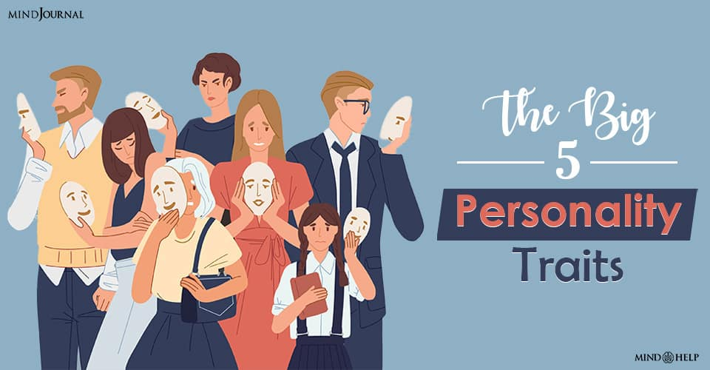
NLP
Libraries/Tools
LIBRARIES:
NLT-K
BERT AND FLAVOURS OF BERT
SPACY
SCI-KIT LEARN
NETWORK-X
TOOLS:
Personality trait feature extraction can be used. Tools like LIWC, NRC, MRC. Other baseline models can be used for comparison.

Slide 12
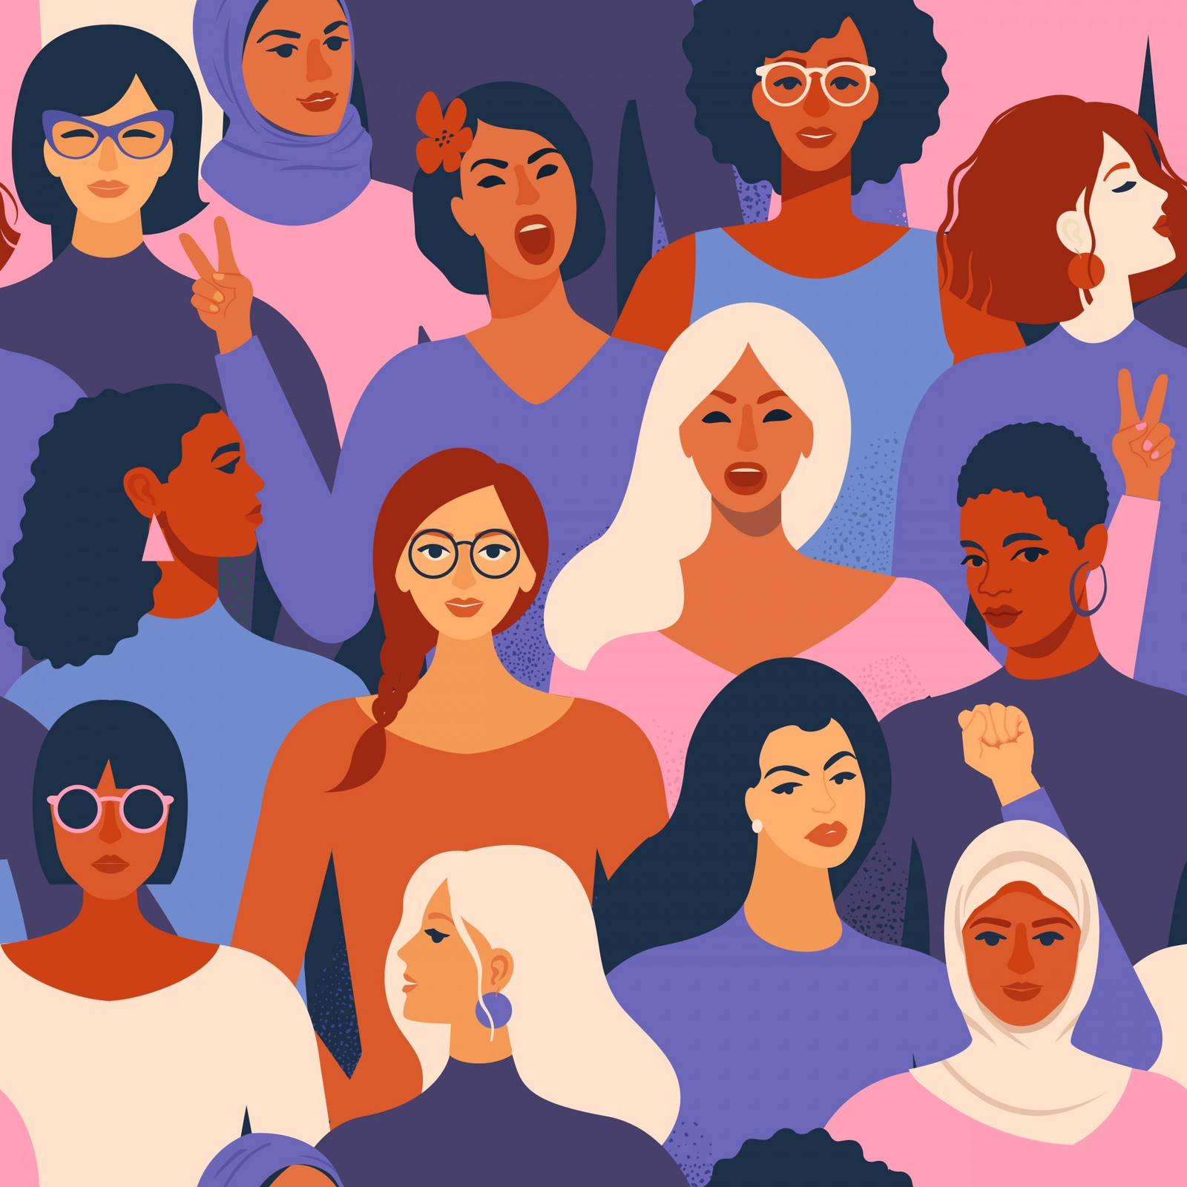






AGE DEMOGRAPHICS AND CHARACTER TRAITS
PERSONALITY W.R.T SOCIAL NETWORK
AGE
OPENNESS
EXTRAVERSION
Characteristics such as imagination, insight, or creativity
excitability, sociability, talkativeness & high amounts of emotional expressiveness
NEUROTICISM
characterized by sadness, moodiness, or emotional instability
AGREEABLENESS
CONSCIENTIOUSNESS
attributes such as trust, altruism, kindness, affection, generosity, or help
involves high levels of thoughtfulness, great impulse control, and goal-oriented behaviors

Slide 13
MILESTONE 1
MILESTONE 3
Literature survey and primary research
Code implementation and results accumulation
JAN
MAY
MILESTONE 2
Dataset collection and Exploratory data analysis
MILESTONE 4
Research paper draft
TIMELINE

